Slide 1
LendingClub data analysis
Sambit

Slide 2
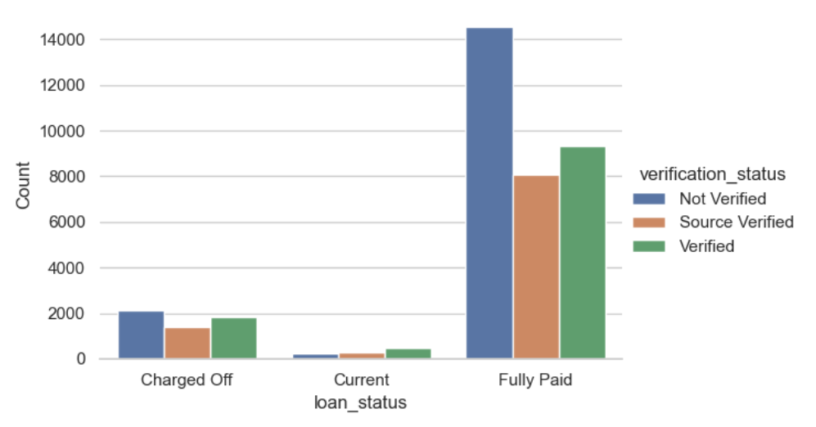
Inference
Correlation of income verification with loan status
Loans for which the income was completely not verified have a slightly higher chance of getting defaulted compared to those loans, where only income source was verified.
However, income verification does not display a very significant role in predicting a loan defaulter within a given data scope.

Slide 3
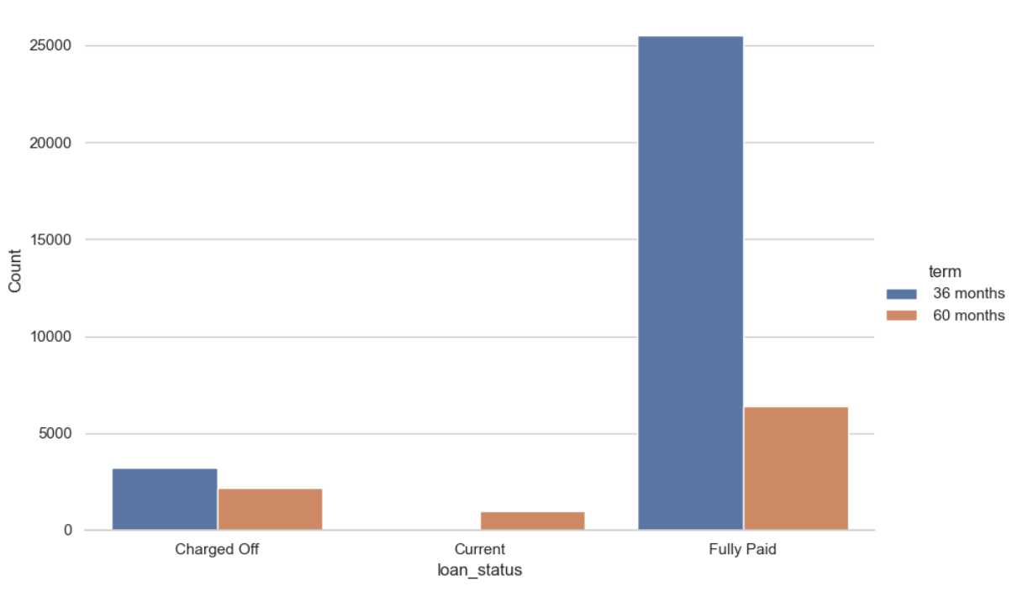
Inference
Correlation of loan term Counts with loan status
The loans with a loan term of 36 months have defaulted more than loans with a total term of 60 months among defaulted loans
Currently no loans are being served with 36 months term.
We can assume that defaulter risk is less in the current scenario within the given data scope

Slide 4
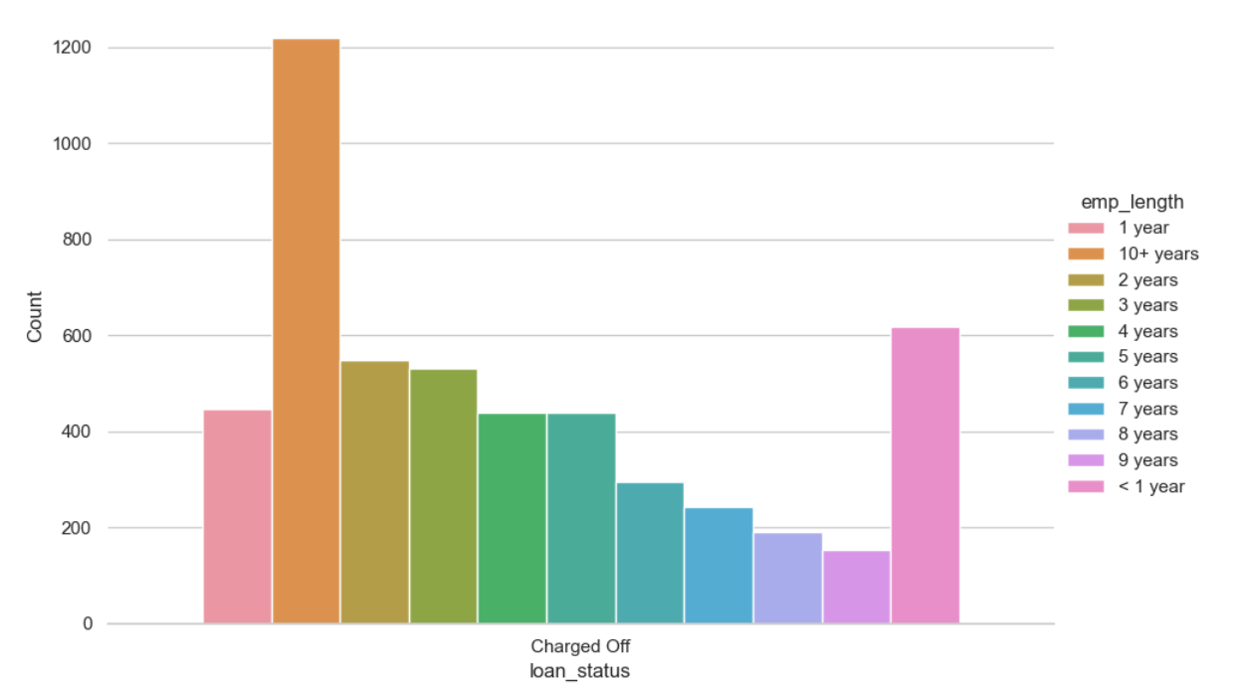
Inference
Correlation of employment length Counts for defaulted loans
It shows that more borrowers with 10+ years of employment have failed to repay a loan.
This might indicate that the employment data provided was fraudulent.
We can further check whether verification was done for these categories.

Slide 5
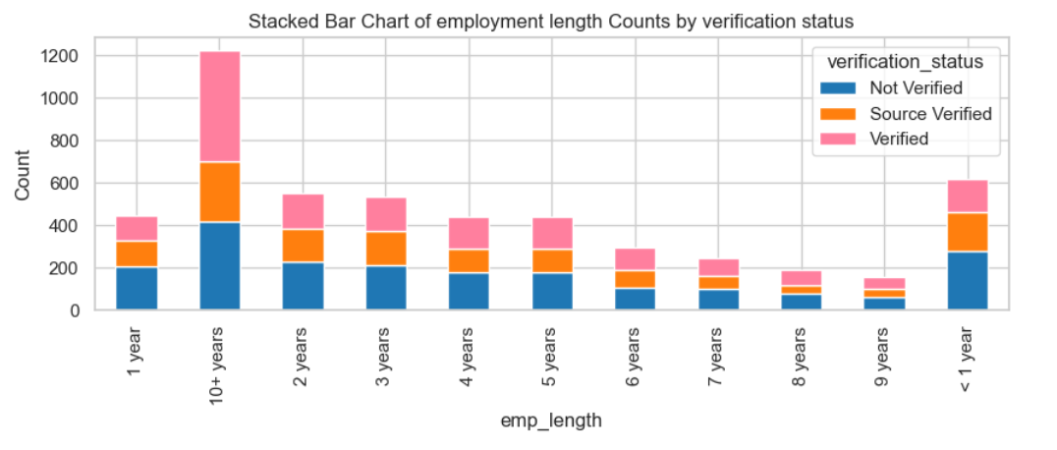
Inference
Correlation of employment length and employment verification for defaulted loans
From the above data we can infer that compared to all employment length brackets, 10+ years borrower's income verification lacked the most.
Also that is the biggest segment where only the source of income was verified.
Segment with employment length brackets of less than 1 year is the second most lacking in income verification.
We can study this on currently serving loans too to see if we can predict any risk

Slide 6
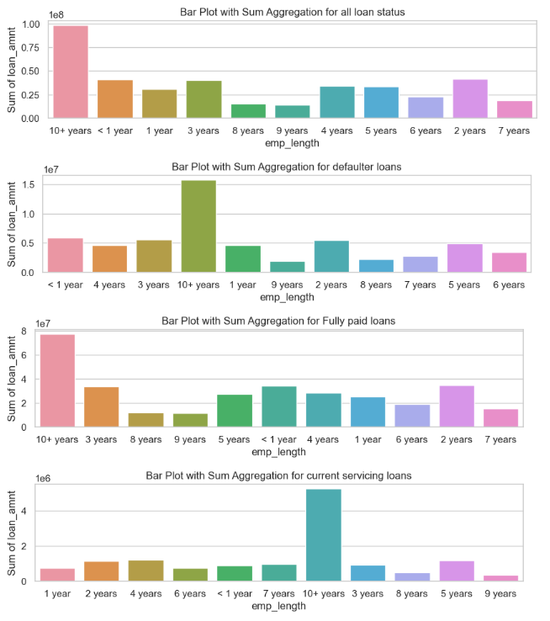
Inference
Correlation of employment length and loan amount for different loan status
Inference
From the above analysis we infer that most loans were given to the 10+ years segment and they have shown a steady defaulter rate
9 years segment was given the least number of loans but they have demonstrated good payback history

Slide 7
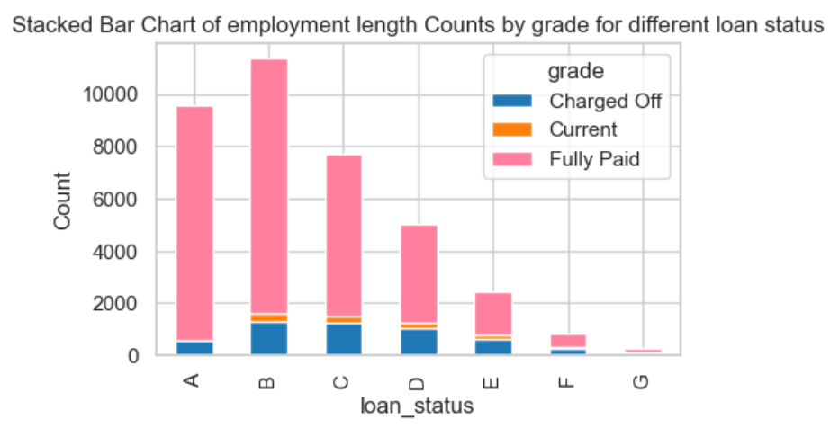
Inference
Correlation of employment length and loan grade for different loan status
Inference
D-grade loans tend to be defaulters. I don't have any insight into how the grading is done.

Slide 8
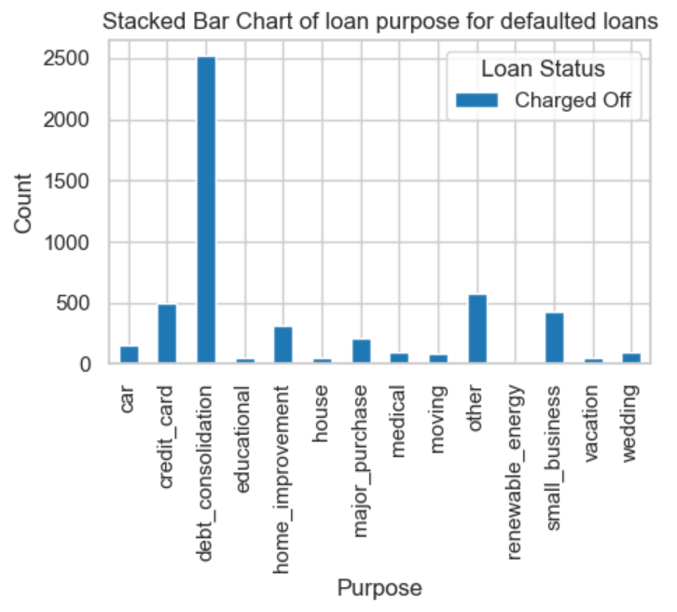
Inference
Correlation of loan purpose for defaulted loans
Most of the borrowers who took loan for debt consolidation purpose could not pay back the loans

Slide 9
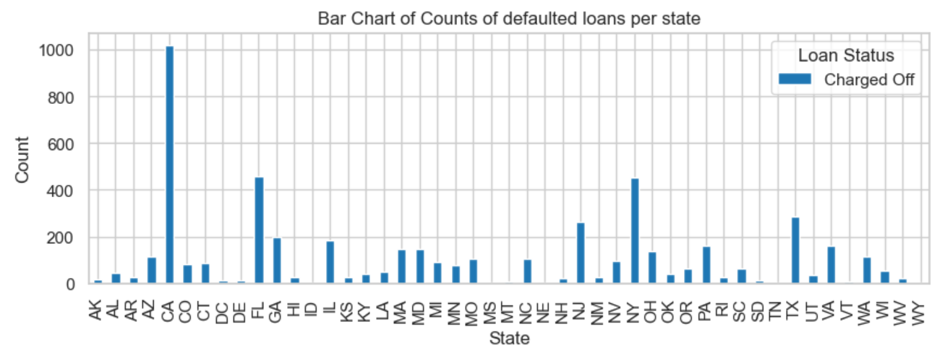
Inference
Correlation of borrower’s state for defaulted loans
Most of the borrowers from CA has defaulted on loan pay back

Slide 10
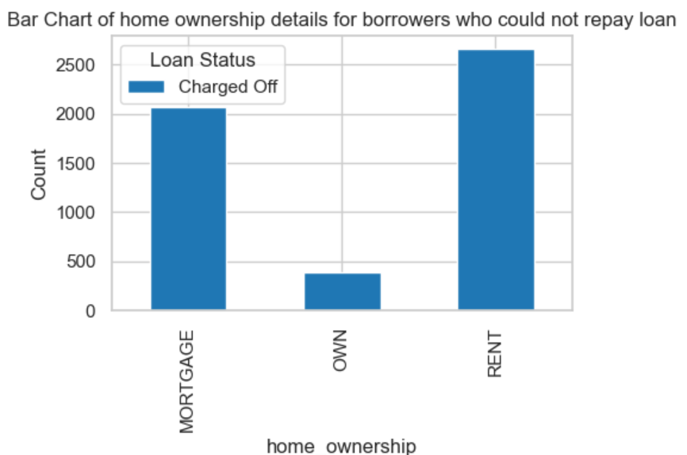
Inference
Correlation of home ownership details for borrowers for defaulted loans
Most of the borrowers staying in rented houses/apartments were not able to repay the loan

